Slide 1
State Penitentiary 3
By: Team E
Edmund, Glenn, Gerald, Troy

Slide 2
VIDEO

Slide 3

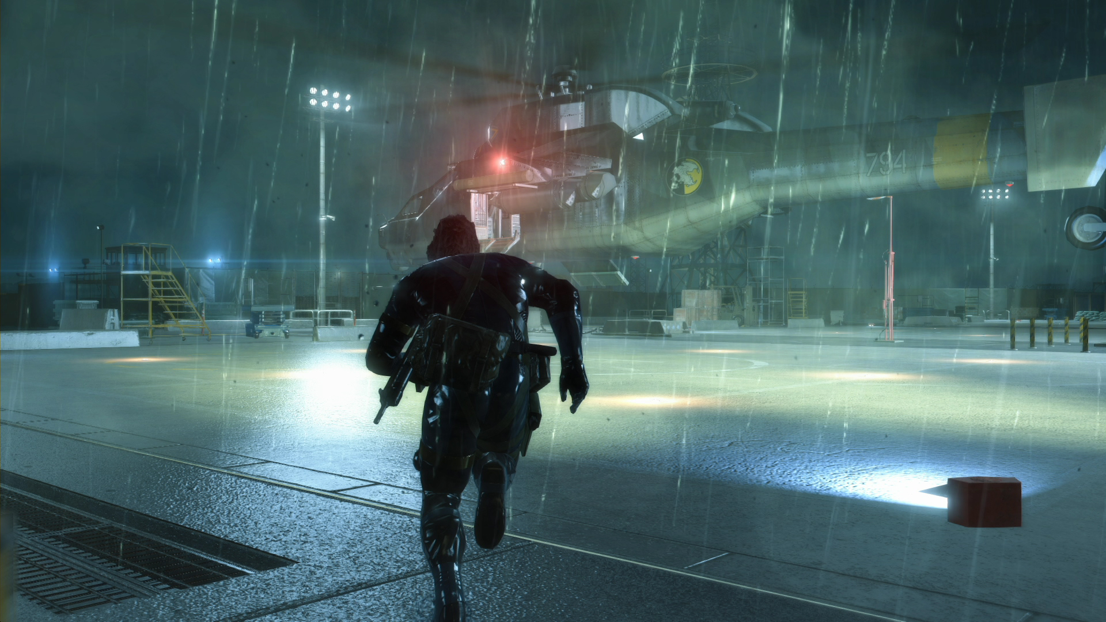
Game Idea inspiration & Concept
Notes:
Glenn

Slide 4


Features(Framework)
Sounds
Frustum Culling
Simple Physics engine
In-game time system
Rain system
AABB Collision detection
Shadows
AI waypoint generator
Modular development of classes
Notes:
Glenn

Slide 5
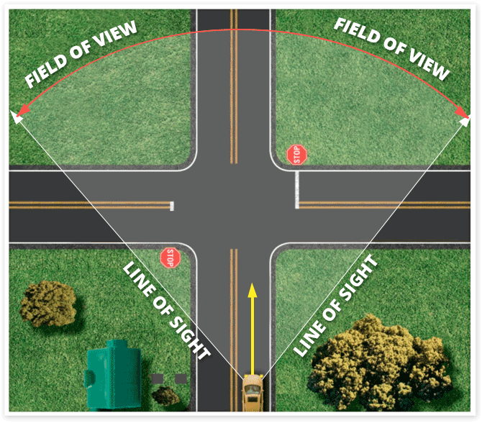

Features (Misc.) Part One
Simple AI
AI waypoint pathfinding
Enemy state
AI Field of View/ Visibility
Urination
Night vision goggles
Invisibility cloak
Inventory system
Dialogue system
Key cards and doors
Notes:
Gerald

Slide 6

Features (Misc.) Part Two
Teru Teru Bozu
Affects AI Visibility
Infrared Security Laser
Game User Interface
Wristwatch
Compass
Nearby Enemy warning HUD
Notes:
Gerald

Slide 7
DEMO
Notes:
Edmund

Slide 8


Controls
Movement – WASD
Jump – Spacebar
Sneak – Control
Sprint – Shift
F – Interact
Q – Activate Night vision goggles
Look – Mouse
Notes:
Edmund

Slide 9
Task break down - Edmund
Framework and Modular base classes for teammates
AI classes and Algorithm
Automatic AI waypoint generator
AI States
AI Field of Vision
Pathfinding
Simple Physics Engine
In-game time system
Dynamic Lighting
Collision Detection + Response
Objective markers
Nearby Enemy Warning HUD
Frustum Culling
Guide and teach teammates
2nd Level of the game
Compass system
Points to nearest objective
Point North
Fix logic errors and warnings
TDD & Slides
Notes:
Edmund

Slide 10
Task break down - Glenn
Framework
Menu system
Player class
Models
Props
Items
Images
Menu
Props
Items
Invisibility
Night Vision Goggles
Features
Invisibility
Peeing
Level Design
Sample Level
Level 1
Notes:
Glenn

Slide 11
Task break down - Gerald
Obj models
Sound
Level 3 design
Dynamic weather
Laser detection
Weather controlling doll
Movements
Notes:
Gerald

Slide 12
Task break down - Troy
Read From Text File
Human Models
Level 4 Design
Interactions
Item Pickup
Unlocking Doors
Features
Key card-locked doors
Key cards
Dialogue
Night Vision Goggles
Notes:
Troy

Slide 13
Gantt Chart
Notes:
Troy

Slide 14
Problems encountered/ solved
Bad coding practices
Hungarian Notation
Logic Errors
Rewrote codes properly
Unhandled exception errors
Debug and use call stack to find the error
Low frame rate
Frustum culling
Object Oriented Programming knowledge not strong
Notes:
All 4

Slide 15
New things learned
Cheap Spatial Partitioning in 3D
Frustum culling
AI waypoint generation & Calculation based on generated values
Interactions via Pythagoras’ theorem and magnitude
Rotation for animation using DegreeToRadians()
Notes:
All 4

